Slide 1

Topic: Ordering decimals, common fractions, percentages
EQ: How can we tell if a value is greater?
Mrs. McLeod

Slide 2
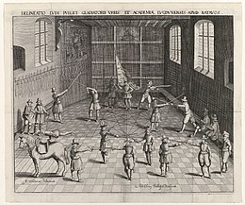
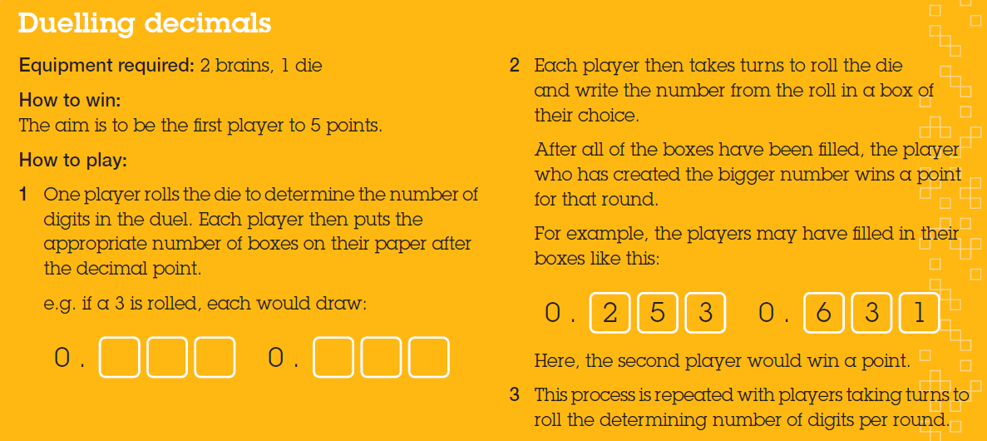
Warm Up

Slide 3
24
7
30
Topic: Ordering decimals, common fractions, percentages
Date
EQ: How can we tell if a value is greater?
Comparing decimals
Real life context: Comparing prices or comparing who won a race
100 m final 2008 Olympics
Usain Bolt won because his time was the smallest number. How much did he win by?
Numbers get larger as we move up the number line from left to right. We can mark off the number line into ten sections between 0 and 1. These would be for the tenths place value of
0.1, 0.2, 0.3, 0.4, 0.5, 0.6, 0.7, 0.8, 0.9 then 1
Number line

Slide 4
24
7
30
Topic: Ordering decimals, common fractions, percentages
Date
EQ: How can we tell if a value is greater?
Comparing decimals
Real life context: Comparing prices or comparing who won a race
Numbers get larger as we move up the number line from left to right. We can mark off the number line into ten sections between 0 and 1. These would be for the tenths place value of
0.1, 0.2, 0.3, 0.4, 0.5, 0.6, 0.7, 0.8, 0.9 then 1
Number line
Draw the tenths on the number line
Where would we place 0.05?
If we then further marked off ten sections between each tenth we would have hundredths (100 tiny intervals between 0 and 1)
-1
0
1
Where would we place -0.35?
Where would we place 0.25?

Slide 5
Which is greater?
0.565 or 0.85
0.2 or 0.04
Important! (add to notes)
The decimal number with the most digits is not necessarily the largest!
A numbers size depends on the value and position of the digits

Slide 6
24
7
30
Topic: Ordering decimals, common fractions, percentages
Date
EQ: How can we tell if a value is greater?
Comparing decimals
Real life context: Comparing prices or comparing who won a race
Comparing decimals using digits
To find the bigger number we can compare the digits in each place value column beginning with the highest place value
Which is bigger 0.47239 or 0.4731?
Compare the whole number first
Then tenths
Then hundredths
Thousandths
Both 0
Both 4
Both 7
2 vs 3 so we don’t need to go any further

Slide 7
Which is greater?
3.5 or 3.51
5.173 or 5.0789
67.54 or 67.504

Slide 8

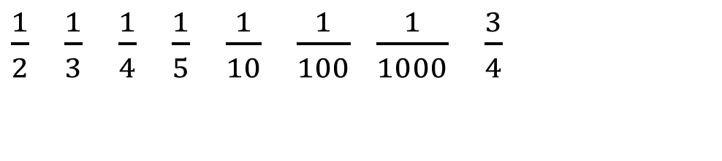

24
7
30
Topic: Ordering decimals, common fractions, percentages
Date
EQ: How can we tell if a value is greater?
Common fractions
$\frac{1}{2}$ $\frac{1}{3}$ $\frac{1}{4}$ $\frac{1}{5}$ $\frac{1}{10}$ $\frac{1}{100} \frac{1}{1000}$ $\frac{3}{4}$
In a few weeks we will be going further with fractions but for now we will just focus on these ones and using the number line to compare
How can we compare them? Which one is greater?
$\frac{1}{2}$ or $\frac{1}{3}$

Slide 9


24
7
30
Topic: Ordering decimals, common fractions, percentages
Date
EQ: How can we tell if a value is greater?
Common fractions
$\frac{1}{2}$ $\frac{1}{3}$ $\frac{1}{4}$ $\frac{1}{5}$ $\frac{1}{10}$ $\frac{1}{100} \frac{1}{1000}$ $\frac{3}{4}$
We can use a number line to compare fractions visually
We can divide up the number line into equal sections on top and bottom
The one to the left is smaller
Number line
How can we compare them? Which one is greater?
$\frac{1}{2}$ or $\frac{1}{3}$
As a class add the other common fractions to the number line
$$\frac{1}{2}$$
-1
0
$$\frac{1}{3}$$
1

Slide 10
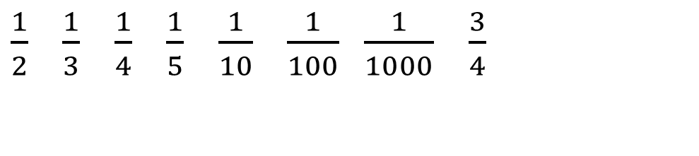

24
7
30
Topic: Ordering decimals, common fractions, percentages
Date
EQ: How can we tell if a value is greater?
$\frac{1}{2}$ $\frac{1}{3}$ $\frac{1}{4}$ $\frac{1}{5}$ $\frac{1}{10}$ $\frac{1}{100} \frac{1}{1000}$ $\frac{3}{4}$
Common fractions
We can use a number line to compare fractions visually
We can divide up the number line into equal sections on top for one fraction and then divide underneath for the other fraction
The one to the left is smaller
Number line
Harder: How can we compare them? Which one is greater?
$\frac{2}{5}$ or $\frac{3}{8}$
-1
0
1
Use the same strategy for this extension question

Slide 11
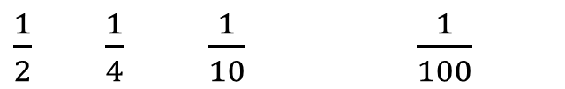
24
7
30
Topic: Ordering decimals, common fractions, percentages
Date
EQ: How can we tell if a value is greater?
Have a think:
How would you place these in order from least to greatest?
How would you put them on a number line?
50% 25% 10% 100% 1%
Common percentages
$\frac{1}{2}$ $\frac{1}{4}$ $\frac{1}{10}$ $\frac{1}{100}$
Which of the common fractions match up to these percentages?
-1
0
1

